Slide 1
Unsupervised Learning: Clustering
Adarsh V Shetty
Karthikeyan R S

Slide 2
Engineering, Test & Technology
Boeing Artificial Intelligence
What is Unsupervised Learning
Discover and learn patterns from unlabeled data without any explicit guidance or instruction.
Types of Unsupervised Learning
Association rule Mining
Dimensionality reduction
Clustering

Slide 3
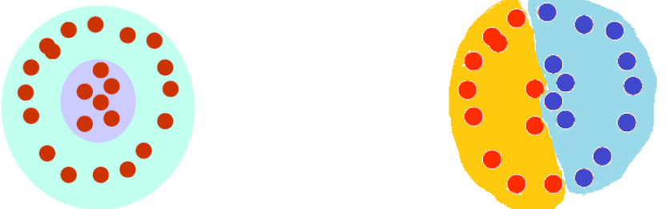
What is clustering?
Engineering, Test & Technology
Boeing Artificial Intelligence
The organization of unlabeled data into similarity groups called clusters.
A cluster is a collection of data items which are “similar” between them, and “dissimilar” to data items in other clusters.

Slide 4







What is the “natural grouping”?
Engineering, Test & Technology
Boeing Artificial Intelligence
Clustering is very subjective!
Distance metric is important!
group by gender
group by source of ability
group by costume

Slide 5
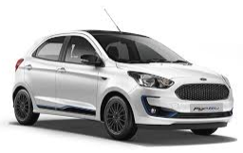
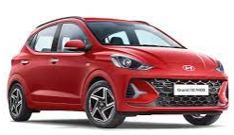
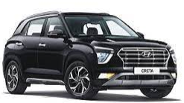
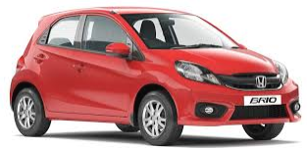
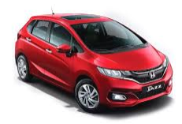
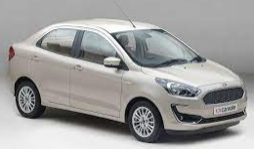
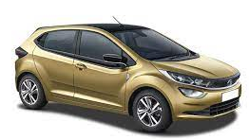
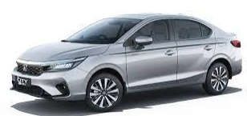
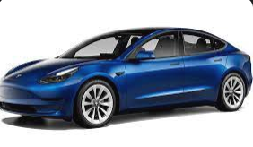
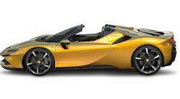

What is the “natural grouping”?
Engineering, Test & Technology
Boeing Artificial Intelligence
5

Slide 6
Clustering problem in general
Engineering, Test & Technology
Boeing Artificial Intelligence
Clustering - the process of grouping a set of objects into clusters of similar objects
Basic criteria
high intra-cluster similarity
low inter-cluster similarity
No (little) supervision signal about the underlying clustering structure
Need similarity/distance as guidance to form clusters

Slide 7
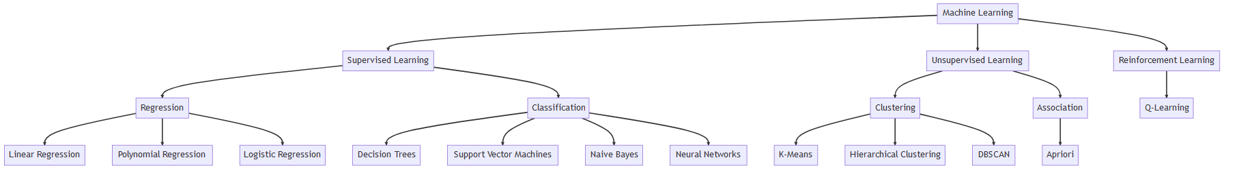
Engineering, Test & Technology
Boeing Artificial Intelligence
Clustering vs classification
Classification is a supervised learning approach that maps an input to an output based on example input-output pairs. Clustering is a unsupervised learning approach.
Classification: If the prediction value tends to be category like yes/no or positive/negative, then it falls under classification type problem in machine learning. The different classes are known in advance. For example, given a sentence, predict whether it's a negative or positive review.
Clustering: Clustering is the task of partitioning the dataset into groups called clusters. The goal is to split up the data in such a way that points within single cluster are very similar and points in different clusters are different. It determines grouping among unlabeled data.
7

Slide 8
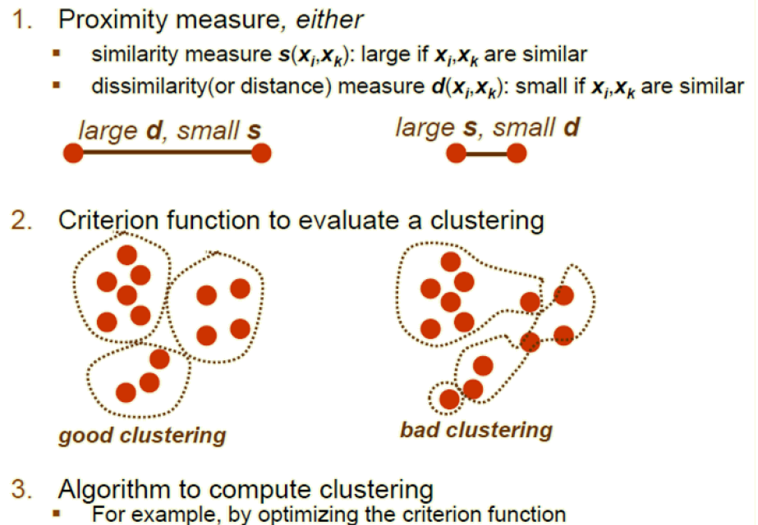
What do we need for clustering?
Engineering, Test & Technology
Boeing Artificial Intelligence

Slide 9
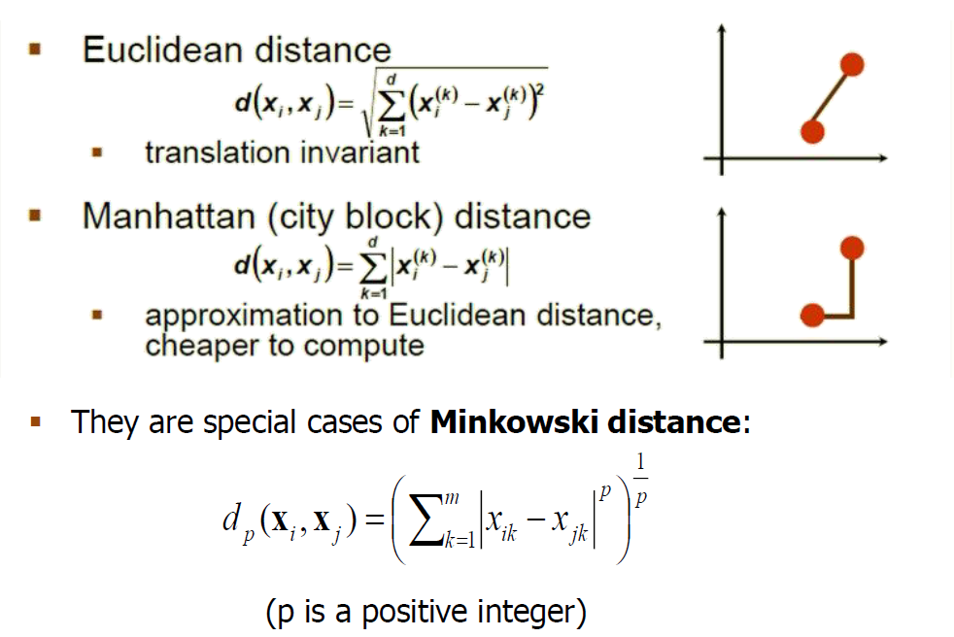
Distance (dissimilarity) measures
Engineering, Test & Technology
Boeing Artificial Intelligence

Slide 10
Cluster evaluation (a hard problem)
Engineering, Test & Technology
Boeing Artificial Intelligence
Intra-cluster cohesion(compactness):
Cohesion measures how near the data points in a cluster are to the cluster centroid.
Sum of squared error (SSE) is a commonly used measure.
Inter-cluster separation(isolation):
Separation means that different cluster centroids should be far away from one another.
In most applications, expert judgments are still the key

Slide 11
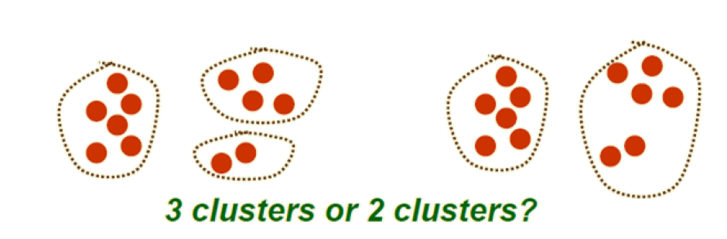
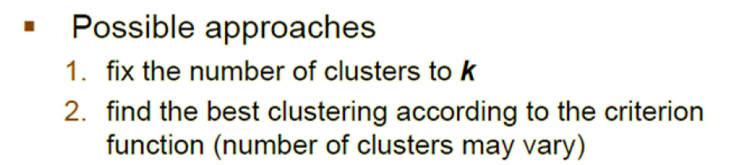
How many clusters?
Engineering, Test & Technology
Boeing Artificial Intelligence

Slide 12
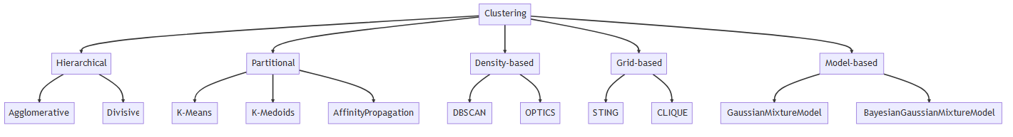
Engineering, Test & Technology
Boeing Artificial Intelligence
Clustering techniques

Slide 13
K-Means clustering
Engineering, Test & Technology
Boeing Artificial Intelligence
K-means (MacQueen, 1967) is a partitional clustering algorithm
Let the set of data points D be {x1, x2, …, xn},
where xi= (xi1, xi2, …, xir) is a vector in X and r is the number of dimensions.
The k-means algorithm partitions the given data into k clusters:
Each cluster has a cluster center, called centroid.
K is specified by the user

Slide 14
K-means algorithm
Engineering, Test & Technology
Boeing Artificial Intelligence
Given k, the k-means algorithm works as follows:
1. Choose k(random) data points (seeds) to be the initial centroids, cluster centers
2. Assign each data point to the closest centroid
3. Re-compute the centroids using the current cluster memberships
4. If a convergence criterion is not met, repeat steps 2 and 3

Slide 15
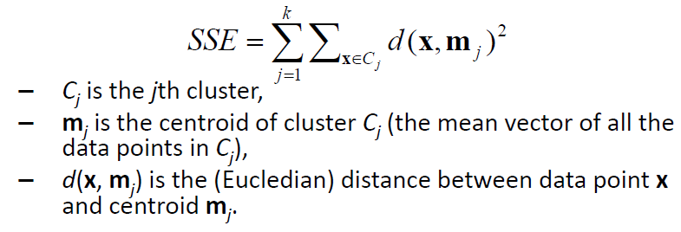
K-means convergence (stopping) criterion
Engineering, Test & Technology
Boeing Artificial Intelligence
no (or minimum) re-assignments of data points to different clusters, or
no (or minimum) change of centroids, or
minimum decrease in the sum of squared error(SSE),

Slide 16
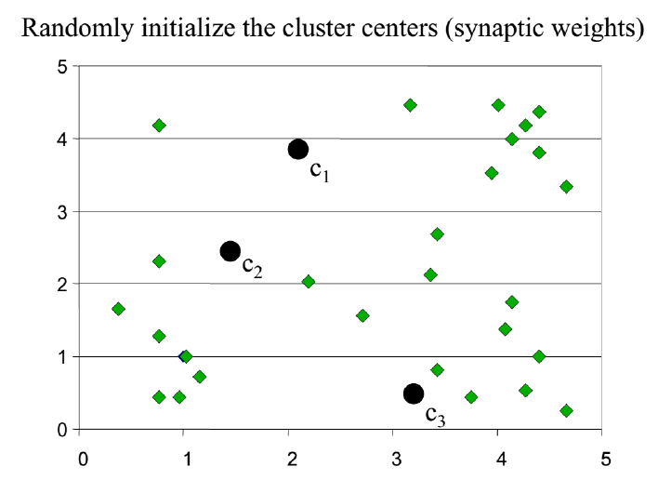
K-means clustering example: step 1
Engineering, Test & Technology
Boeing Artificial Intelligence

Slide 17
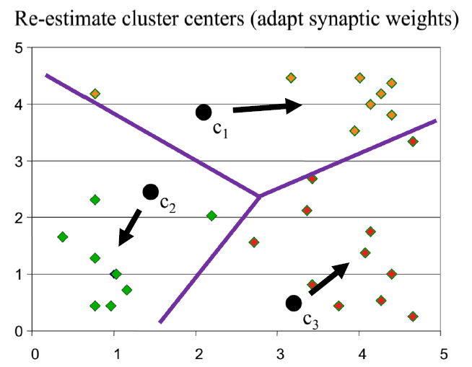
K-means clustering example –step 2
Engineering, Test & Technology
Boeing Artificial Intelligence

Slide 18
K-means clustering example
Engineering, Test & Technology
Boeing Artificial Intelligence

Slide 19
K-means clustering example
Engineering, Test & Technology
Boeing Artificial Intelligence

Slide 20
K-means clustering example
Engineering, Test & Technology
Boeing Artificial Intelligence

Slide 21
Why use K-means?
Engineering, Test & Technology
Boeing Artificial Intelligence
Strengths:
Simple: easy to understand and to implement
Efficient: Time complexity: O(tkn),
where n is the number of data points,
K is the number of clusters, and
t is the number of iterations.
Since both k and t are small. k-means is considered a linear algorithm.
K-means is the most popular clustering algorithm.
Note that: it terminates at a local optimum if SSE is used. The global optimum is hard to find due to complexity.

Slide 22
Weaknesses of K-means
Engineering, Test & Technology
Boeing Artificial Intelligence
The algorithm is only applicable if the mean is defined.
For categorical data, k-mode -the centroid is represented by most frequent values.
The user needs to specify k.
The algorithm is sensitive to outliers
Outliers are data points that are very far away from other data points.
Outliers could be errors in the data recording or some special data points with very different values.

Slide 23
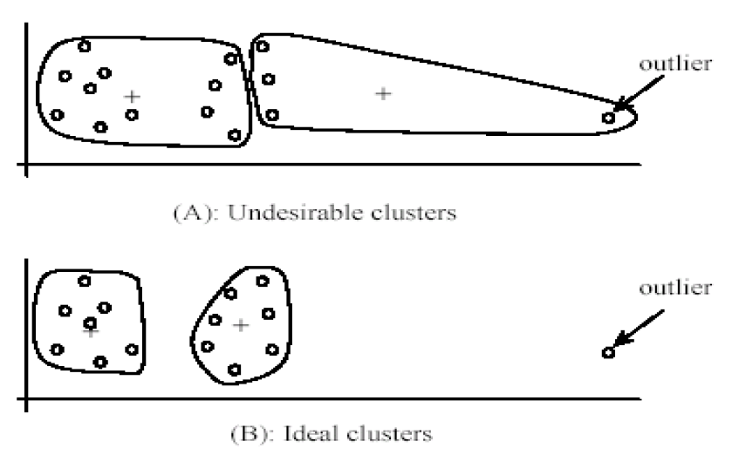
Outliers
Engineering, Test & Technology
Boeing Artificial Intelligence

Slide 24
Dealing with outliers
Engineering, Test & Technology
Boeing Artificial Intelligence
Remove some data points that are much further away from the centroids than other data points
To be safe, we may want to monitor these possible outliers over a few iterations and then decide to remove them.
Perform random sampling: by choosing a small subset of the data points, the chance of selecting an outlier is much smaller
Assign the rest of the data points to the clusters by distance or similarity comparison, or classification

Slide 25
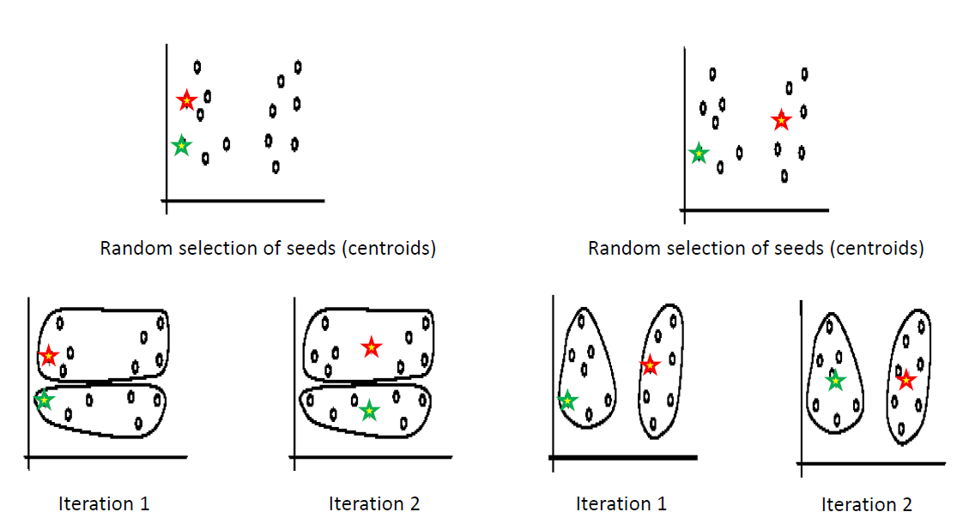
Sensitivity to initial seeds
Engineering, Test & Technology
Boeing Artificial Intelligence

Slide 26
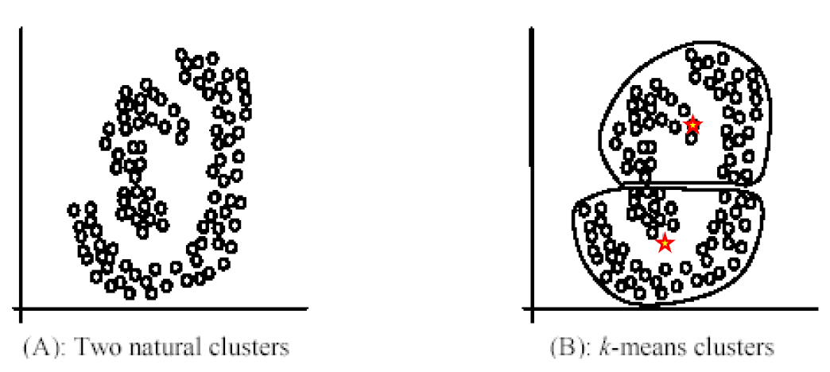
Special data structures
Engineering, Test & Technology
Boeing Artificial Intelligence
The k-means algorithm is not suitable for discovering clusters that are not hyper-ellipsoids (or hyper-spheres).

Slide 27

Optimizing the Number of Clusters in K-means
Engineering, Test & Technology
Boeing Artificial Intelligence
Two common methods:
Silhouette Score
Elbow Method.
Silhouette Score
Measures how similar an object is to its own cluster compared to other clusters.
s(i) is the Silhouette Score for data point i
a(i) is the average distance from the ith data point to the other data points in the same cluster.
b(i) is the smallest average distance from the ith data point to data points in a different cluster.
The overall Silhouette Score for the dataset is the average of the Silhouette Score for each instance.
You choose the number that gives the highest Silhouette Score.

Slide 28

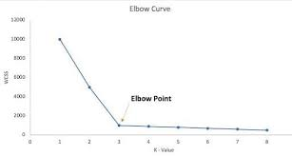
Optimizing the Number of Clusters in K-means
Engineering, Test & Technology
Boeing Artificial Intelligence
2. Elbow Method
Within-cluster sum of squares (WCSS) is plotted for a range of cluster numbers (k). WCSS is the sum of the squared distance between each point in a cluster and the centroid of that cluster.
Where:
k is the number of clusters.
n is the number of points in a cluster.
xj is a point in a cluster.
ci​ is the centroid of a cluster.
As the number of clusters increases, the WCSS decreases.
The point where the rate of decrease sharply changes, representing an 'elbow' in the graph, is considered an optimal number of clusters.
Beyond this point, the gains from increasing the number of clusters are usually marginal or negligible.

Slide 29
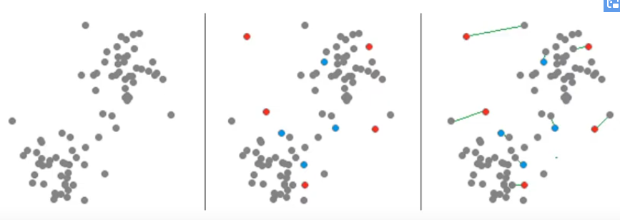
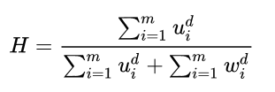
Engineering, Test & Technology
Boeing Artificial Intelligence
Hopkins Statistics
A typical formulation of the Hopkins statistic follows
Let X be the set of n data points.
Consider a random sample (without replacement) of m ≪ n data points with members xi
Generate a set Y of m uniformly randomly distributed data points.
Define two distance measures,
ui , the distance of yi ∈ Y from its nearest neighbour in X, and
wi , the distance of m number of randomly chosen xi , xi ∈ X from its nearest neighbour X.
Random data
Data point
H>0.8 == Good clusters in your data
H 0.5-0.8== Ok
H<= 0.5: Random, not good for clustering

Slide 30
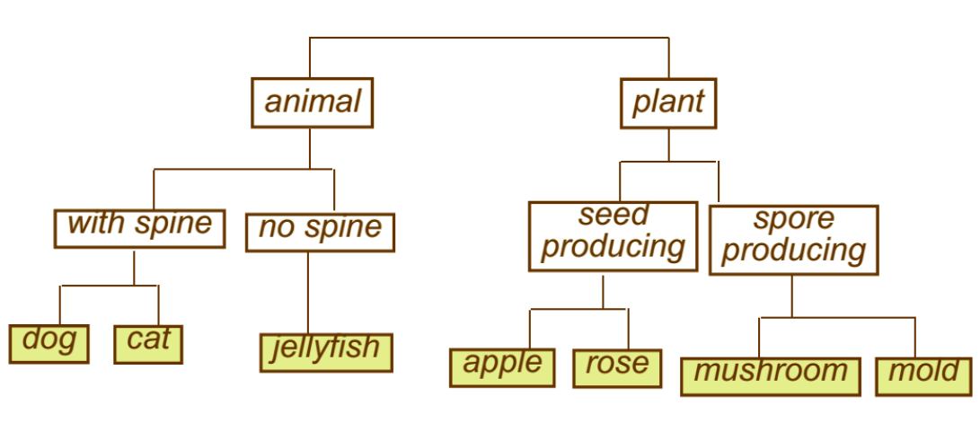
Example: Biological taxonomy
Engineering, Test & Technology
Boeing Artificial Intelligence
Hierarchical clustering
Hierarchical clustering is an unsupervised machine learning technique that groups data points into a tree-like hierarchy of clusters, represented by a dendrogram.

Slide 31
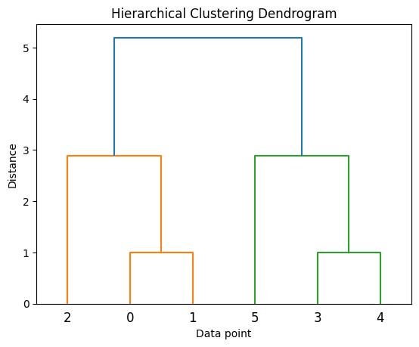
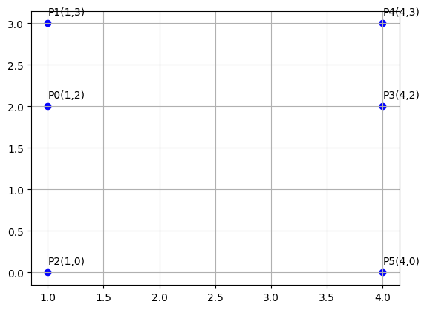
Hierarchical clustering
Engineering, Test & Technology
Boeing Artificial Intelligence

Slide 32
Types of hierarchical clustering
Engineering, Test & Technology
Boeing Artificial Intelligence
Divisive (top down) clustering: Starts with all data points in one cluster, the root, then
Splits the root into a set of child clusters. Each child cluster is recursively divided further
stops when only singleton clusters of individual data points remain, i.e., each cluster with only a single point
Agglomerative (bottom up) clustering: The dendrogram is built from the bottom level by
merging the most similar (or nearest) pair of clusters
stopping when all the data points are merged into a single cluster (i.e., the root cluster).

Slide 33
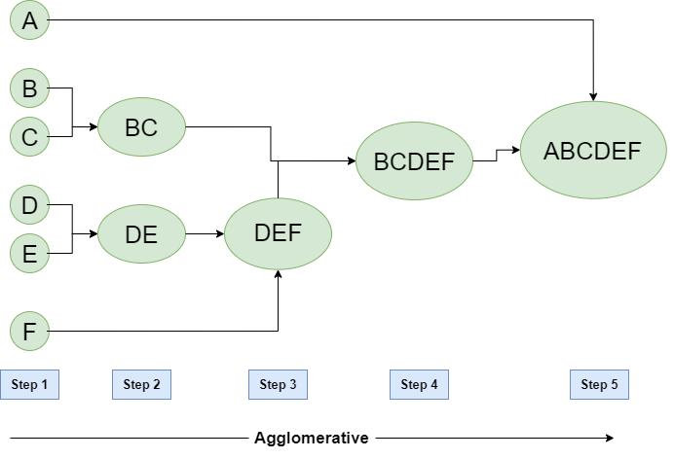
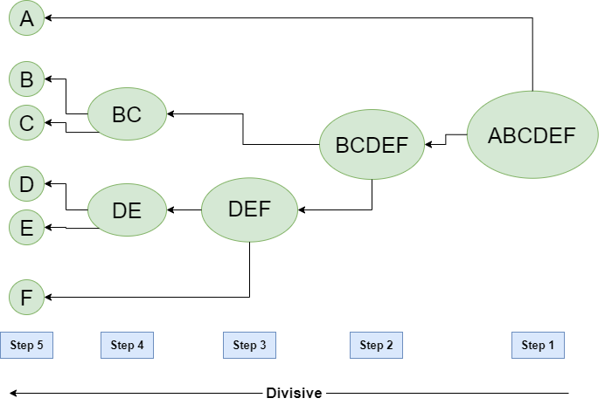
Hierarchical clustering
Engineering, Test & Technology
Boeing Artificial Intelligence
Agglomerative (bottom up) clustering
Divisive (top down) clustering

Slide 34
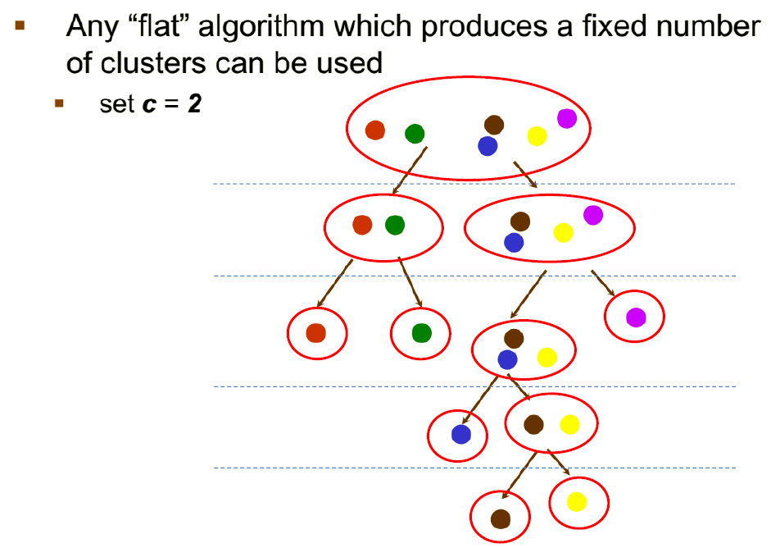
Divisive hierarchical clustering
Engineering, Test & Technology
Boeing Artificial Intelligence

Slide 35
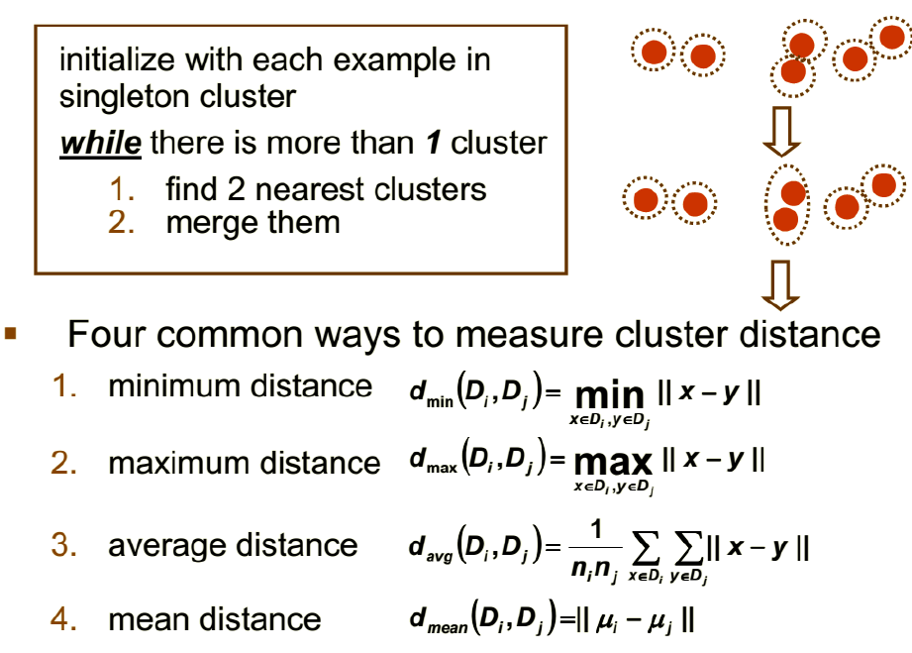
Agglomerative hierarchical clustering
Engineering, Test & Technology
Boeing Artificial Intelligence

Slide 36
DBSCAN Algorithm
Engineering, Test & Technology
Boeing Artificial Intelligence
DBSCAN algorithm groups together closely packed points or regions of high density and separates regions of low point density.
The user specifies two parameters: epsilon ϵ (eps) and the minimum number of points required to form a dense region (minPts).
Algorithm
For each point in the dataset, determine the neighboring points within epsilon ϵ distance.
If a point has at least minPts neighboring points, create a new cluster and include all the reachable points in this cluster.
Assign each point to a specific cluster or mark it as noise (a point that is not part of any cluster) based on the density.
Continue the process until all the points are either assigned to a cluster or marked as noise.
This algorithm does not require the user to specify the number of clusters in advance, unlike K-means. It can discover clusters of arbitrary shape, and it is robust to outliers.
36

Slide 37
DBSCAN – Stopping Criteria
Engineering, Test & Technology
Boeing Artificial Intelligence
DBSCAN stops when:
Every point in the dataset has been visited.
All points have been assigned to a cluster or marked as noise, based on the density criteria.
In DBSCAN, there is no concept of centroid or sum of squared error (SSE), as in K-means, since it does not compute the center of clusters and it can find arbitrarily shaped clusters.
The clusters are formed based on the density of data points in the region, and the algorithm terminates once all the points are either assigned to a cluster or marked as noise, based on the specified ϵ\epsilonϵ and minPts parameters.

Slide 38
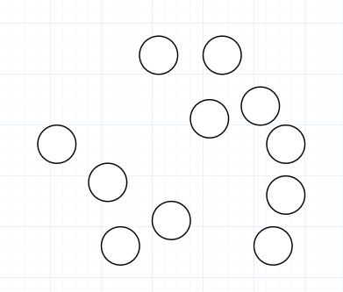
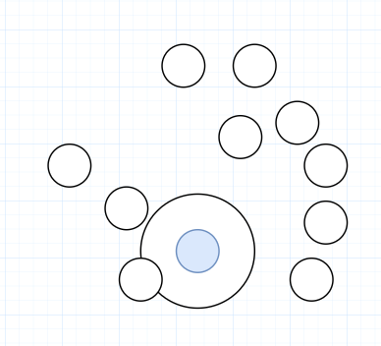
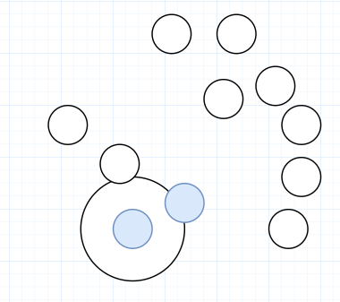
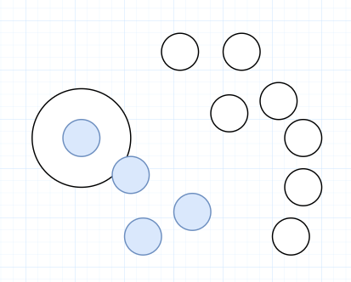
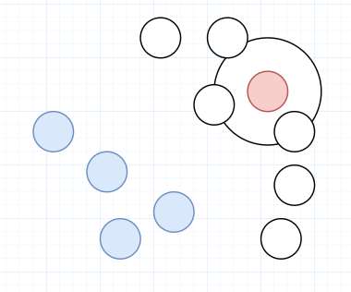
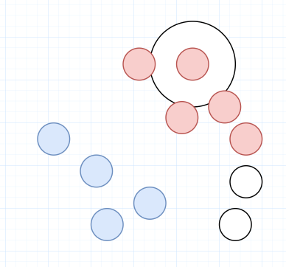
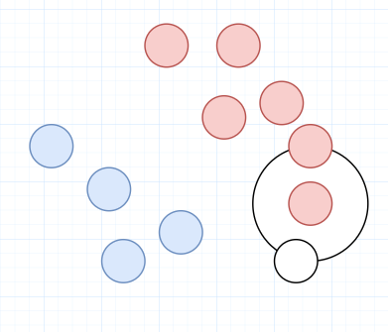
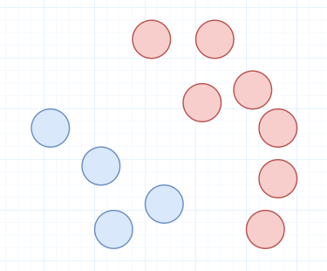
DBSCAN
Engineering, Test & Technology
Boeing Artificial Intelligence

Slide 39
APPENDIX
Engineering, Test & Technology
Boeing Artificial Intelligence

Slide 40
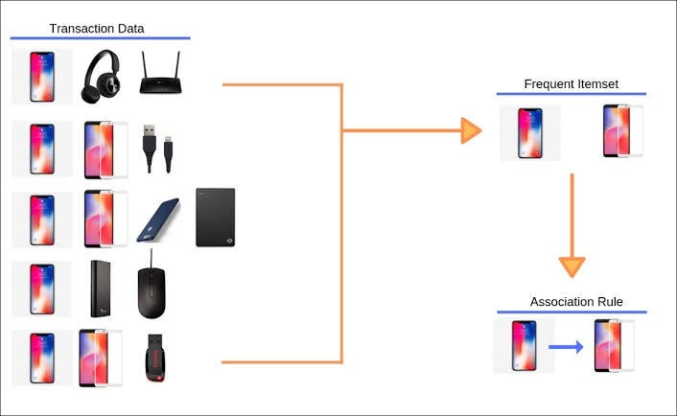
Engineering, Test & Technology
Boeing Artificial Intelligence
Association rule Mining
Uncover how items are associated to each other.
Predicts occurrence of an item based on occurrences of other item in the transaction
Fig. adapted from rsquaredacademy

Slide 41
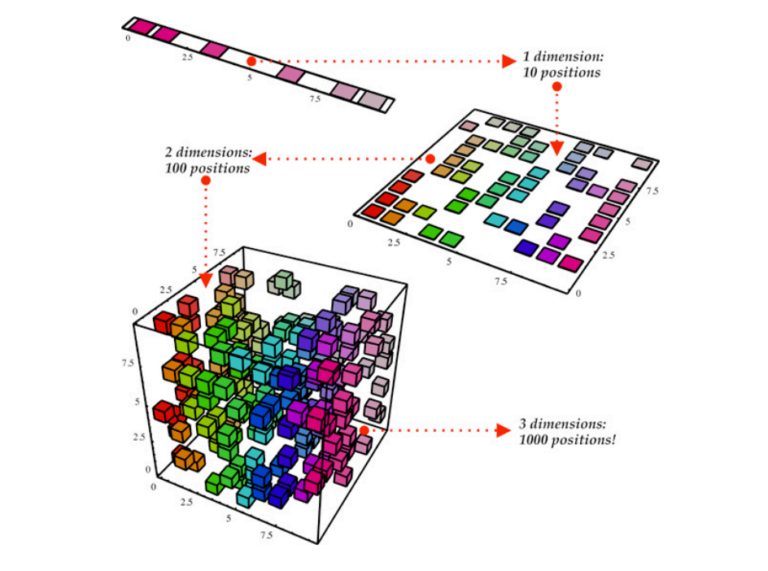
Engineering, Test & Technology
Boeing Artificial Intelligence
Dimensionality Reduction
Reducing the number of features in a dataset while retaining most of the information.
Common Algorithms
Principal Component Analysis ( PCA )
Linear Discriminant Analysis (LDA)
t-distributed Stochastic Neighbor Embedding (t-SNE)
Fig. adapted from pinecone

Slide 42
Visualization Tools
Engineering, Test & Technology
Boeing Artificial Intelligence
https://www.naftaliharris.com/blog/visualizing-k-means-clustering/
https://clustering-visualizer.web.app

